Slide 1

IBM Data Science Capstone
Opening a new fast food joint in CABA, Argentina

Slide 2
Introduction
CABA is the most popular and populated city in Argentina made of 48 neighborhoods.
In the last few years there has been a tren of opening fast food joints
In this final Capstone I am going to analyze which naighborhood in CABA is the best to open a new fast food joint.
To do that i´m using K-Means Clustering in order to get relevant information about the neighborhoods.

Slide 3

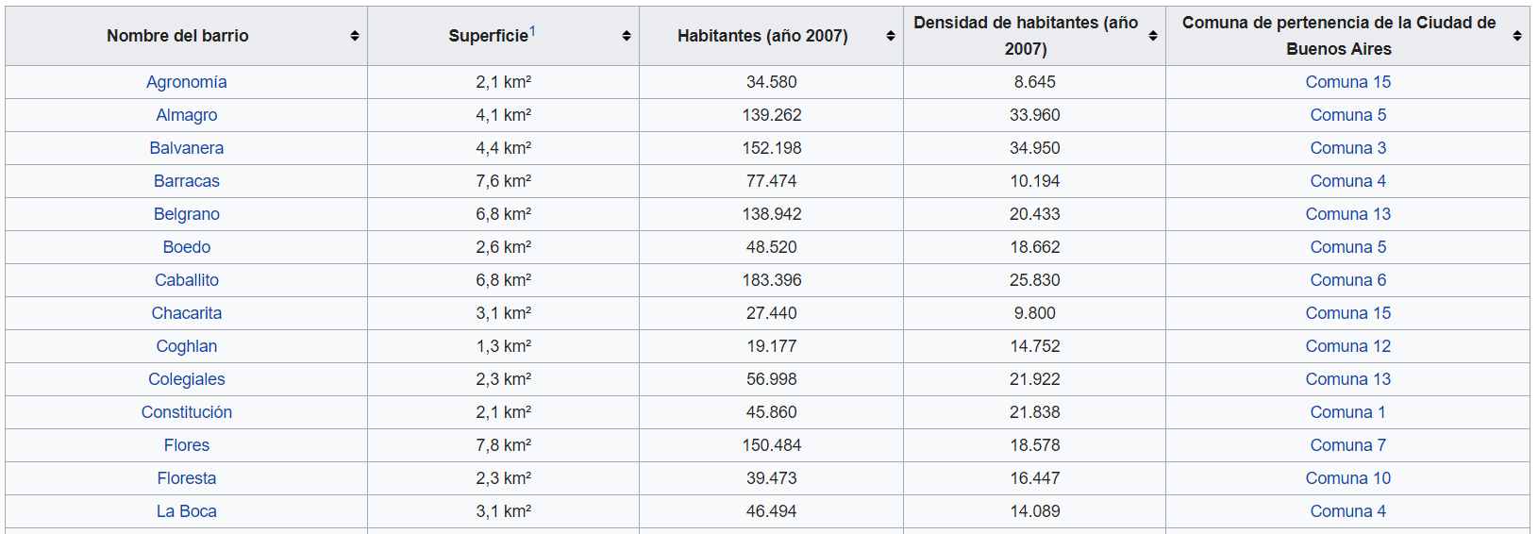

Data

Slide 4
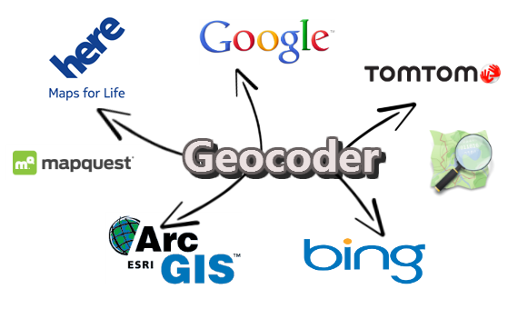

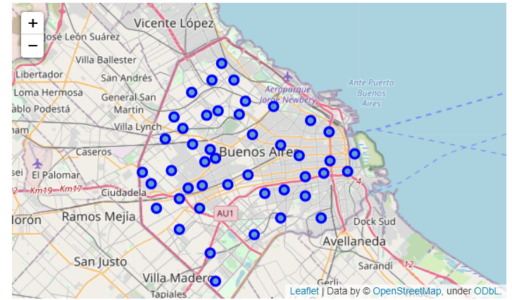
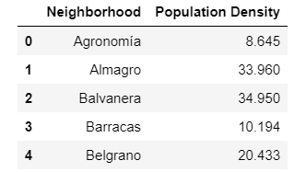
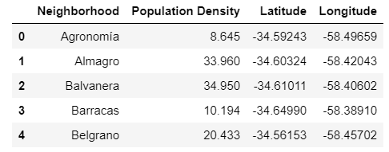
Methodology

Slide 5
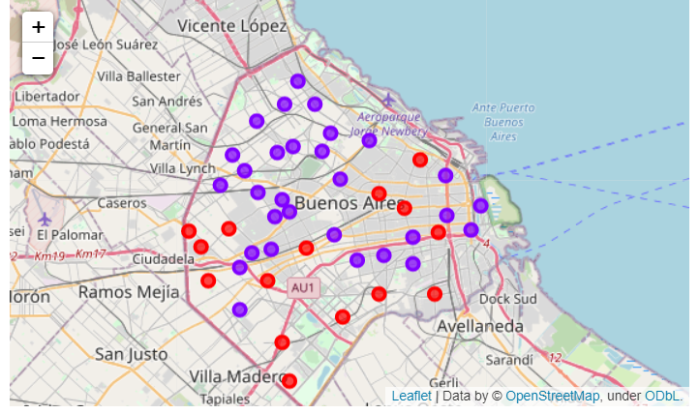
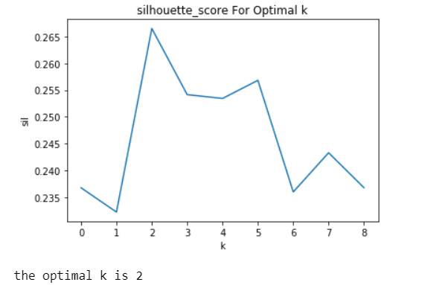
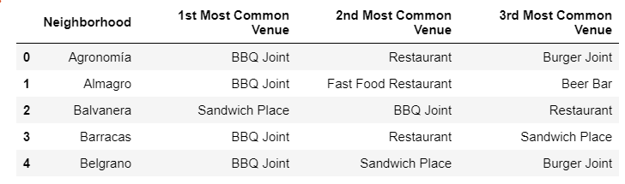

Slide 6
Results
Cluster 1: has a more varied mix of joints.
Cluster 2: is also varied but with more BBQ joints over any other type of joint.
Result is affected by the quarantine and covid-19
Cluster 1

